Slide 1
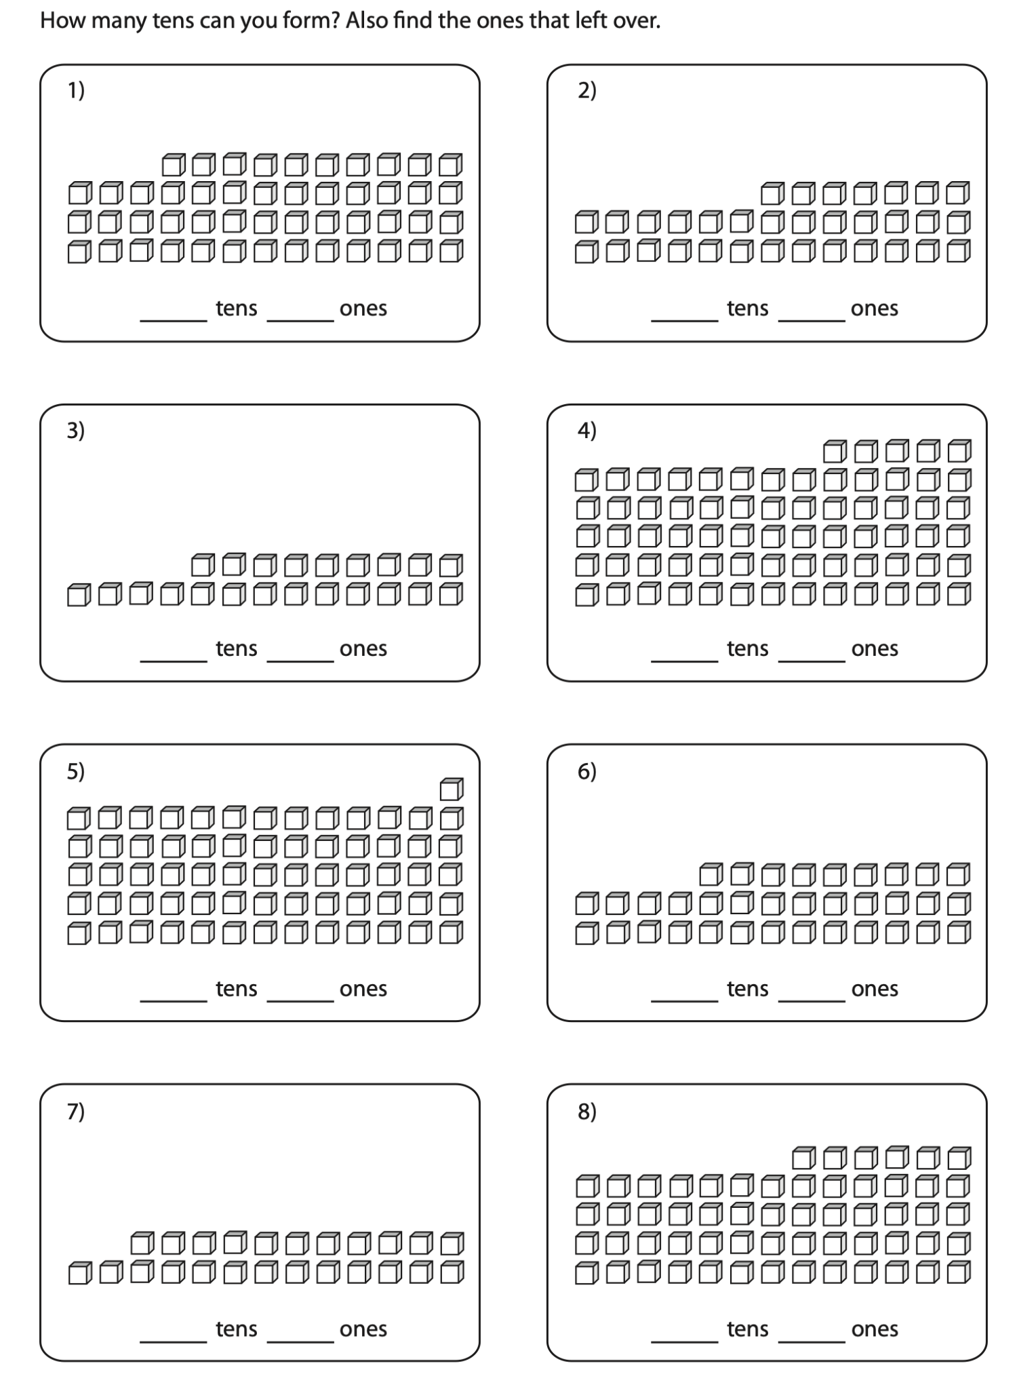

This is 10

Slide 2
How many is this?

Slide 3
How many is this?
10

Slide 4
How many is this?
10
20

Slide 5
How many is this?

Slide 6
How many is this?
10

Slide 7
How many is this?
10
20

Slide 8
How many is this?
10
20
30

Slide 9
How many is this?
10
20
30
40

Slide 10
How many is this?
10
20
30
40
50

Slide 11
How many is this?
10
20
30
40
50
60

Slide 12
How many is this?

Slide 13
How many is this?
10

Slide 14
How many is this?
10
20

Slide 15
How many is this?
10
20
26

Slide 16
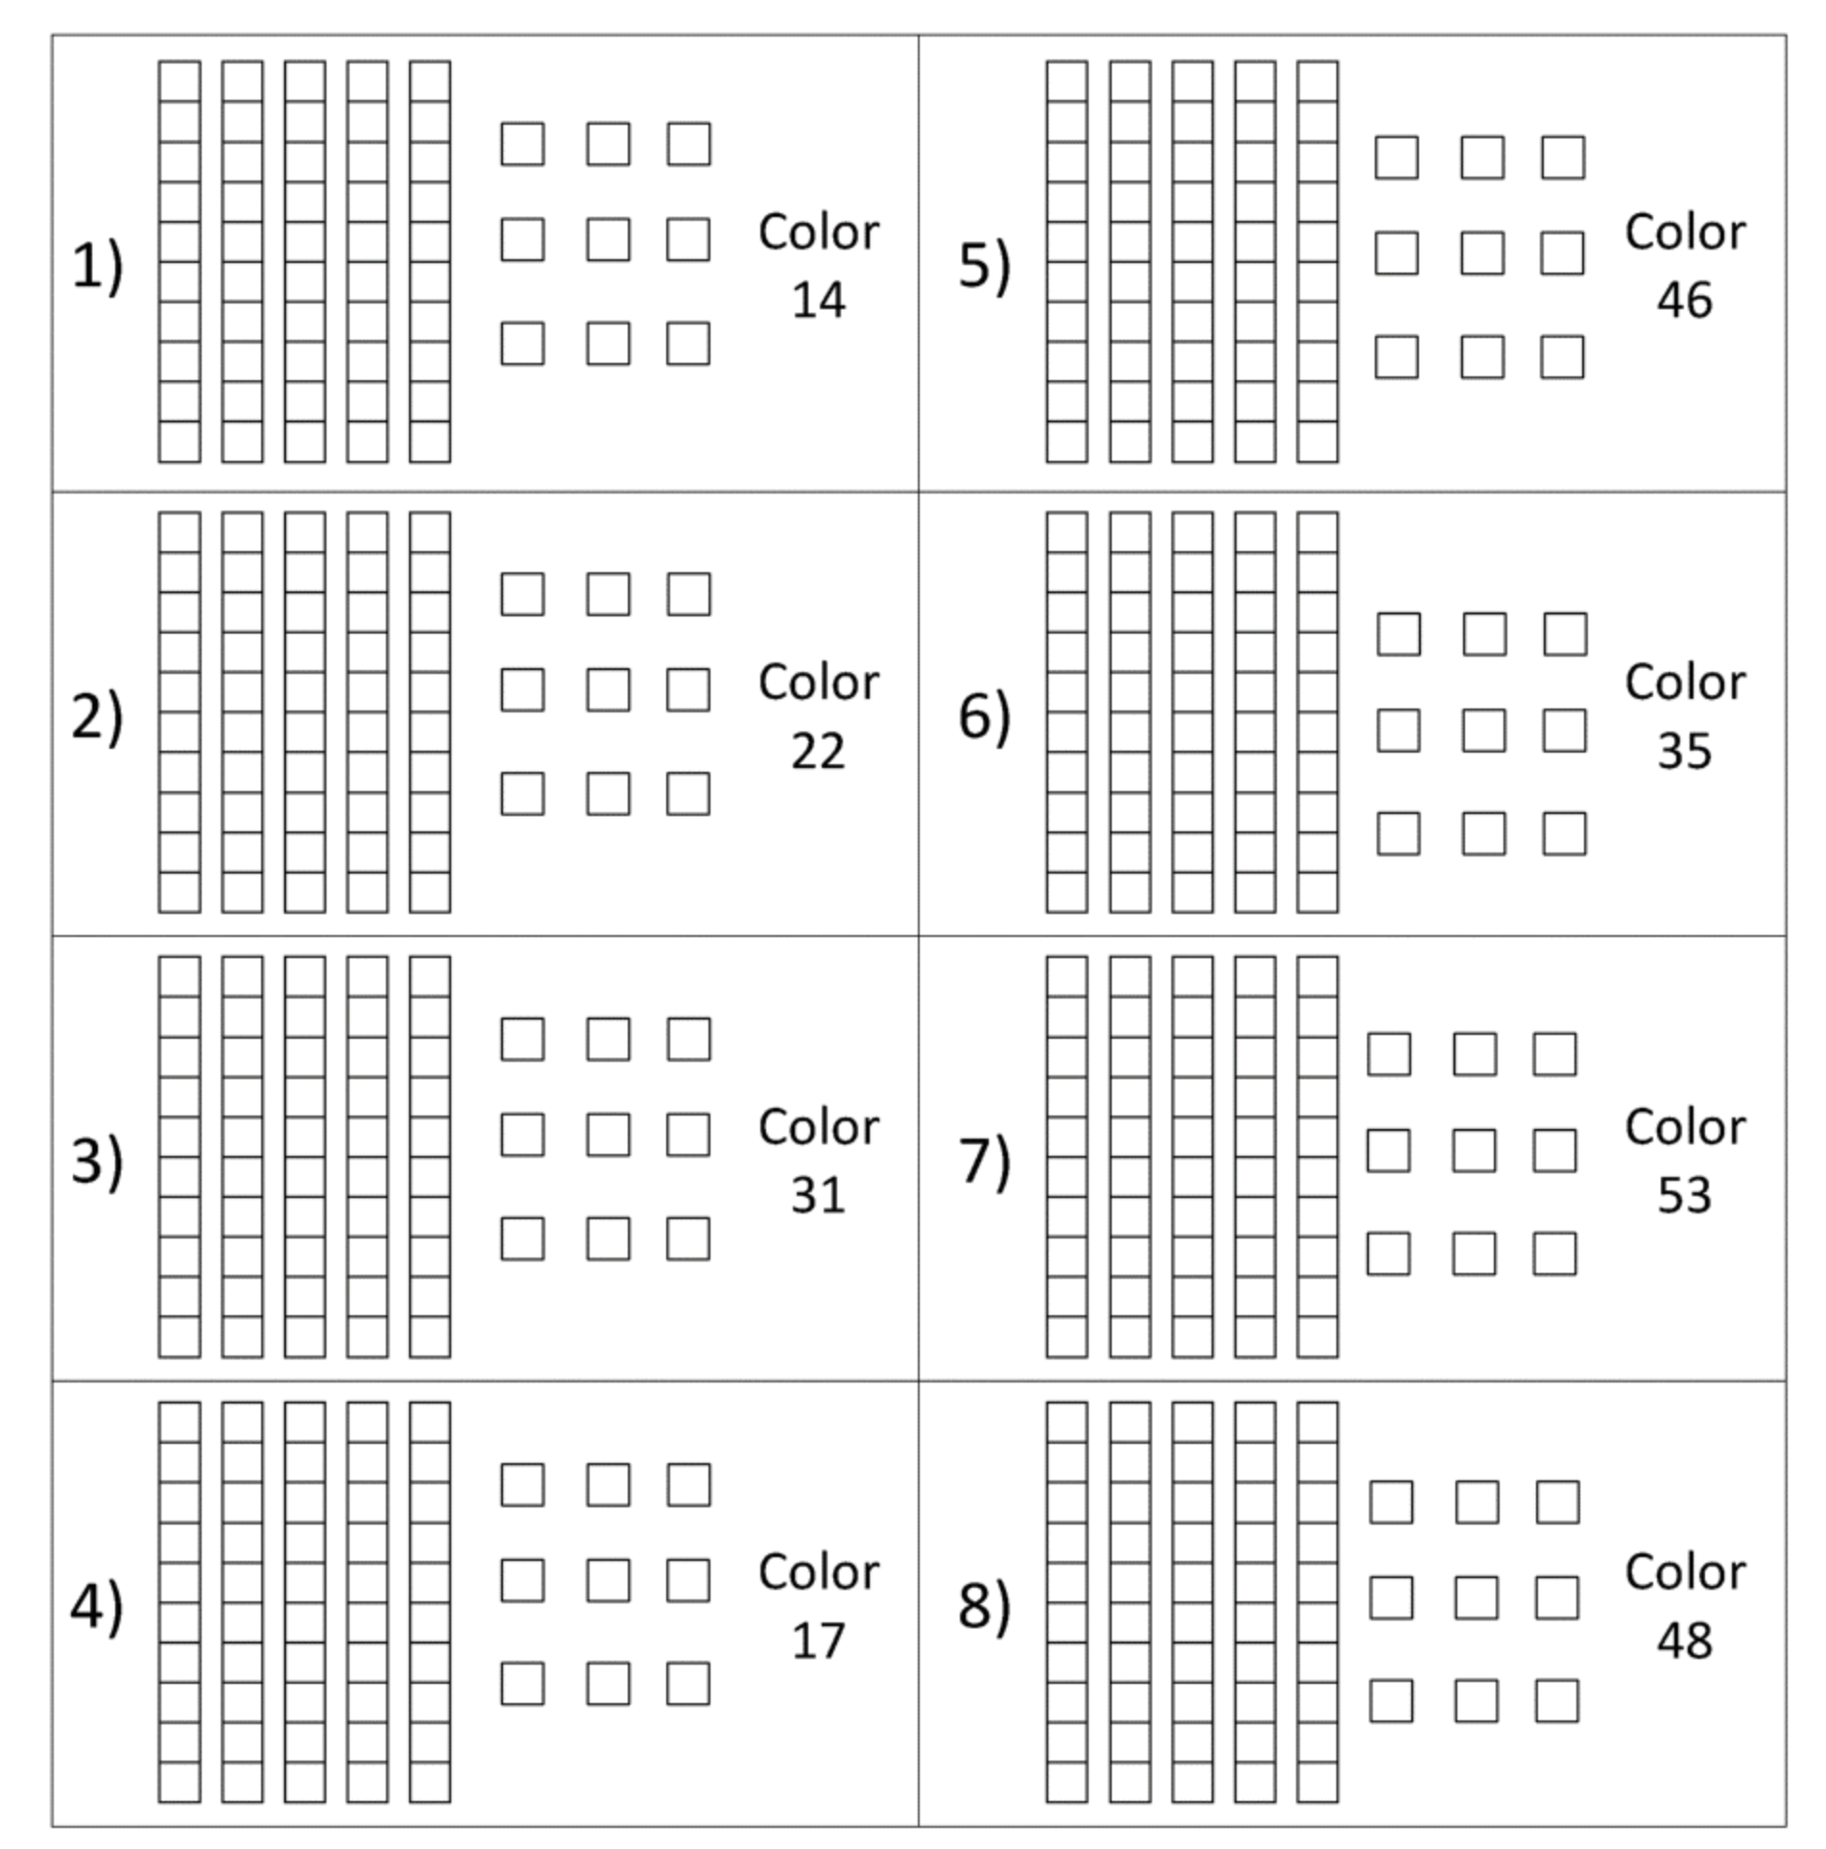
This is 10

Slide 17
This is 10

Slide 18
This is 10
We can join these together

Slide 19
This is 10
We can join these together

Slide 20
This is 10

Slide 21
This is 10
How many ones are there in this 10?

Slide 22
This is 10
How many ones are there in this 10?
There are 10 ones

Slide 23
This is 10
How many tens are there in this 10?

Slide 24
This is 10
How many tens are there in this 10?
There is 1 ten

Slide 25
What value is this?

Slide 26
What value is this?
43

Slide 27
What value is this?
How many tens are there?
43

Slide 28
What value is this?
How many tens are there? There are 4 tens
43

Slide 29
What value is this?
How many extra ones are there?
43

Slide 30
What value is this?
How many extra ones are there? There are 3
43

