Slide 1
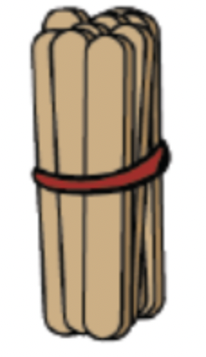
How many are there in a bundle?

Slide 2
10

Slide 3
If we had two bundles

Slide 4
If we had two bundles

Slide 5
How many is that?

Slide 6
How many is that?
20

Slide 7
How many?

Slide 8
How many?

Slide 9
How many?
50

Slide 10
How many?

Slide 11
How many?

Slide 12
How many?
60

Slide 13
How many?

Slide 14
How many?

Slide 15
How many?
30

Slide 16
How many?

Slide 17
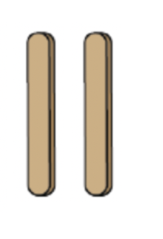
How many?

Slide 18
How many?
2

Slide 19
How many?

Slide 20
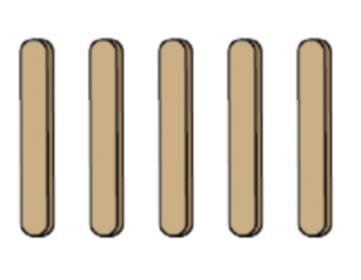
How many?

Slide 21
How many?
5

Slide 22
How many?

Slide 23
How many?

Slide 24
How many?
25

