Slide 1
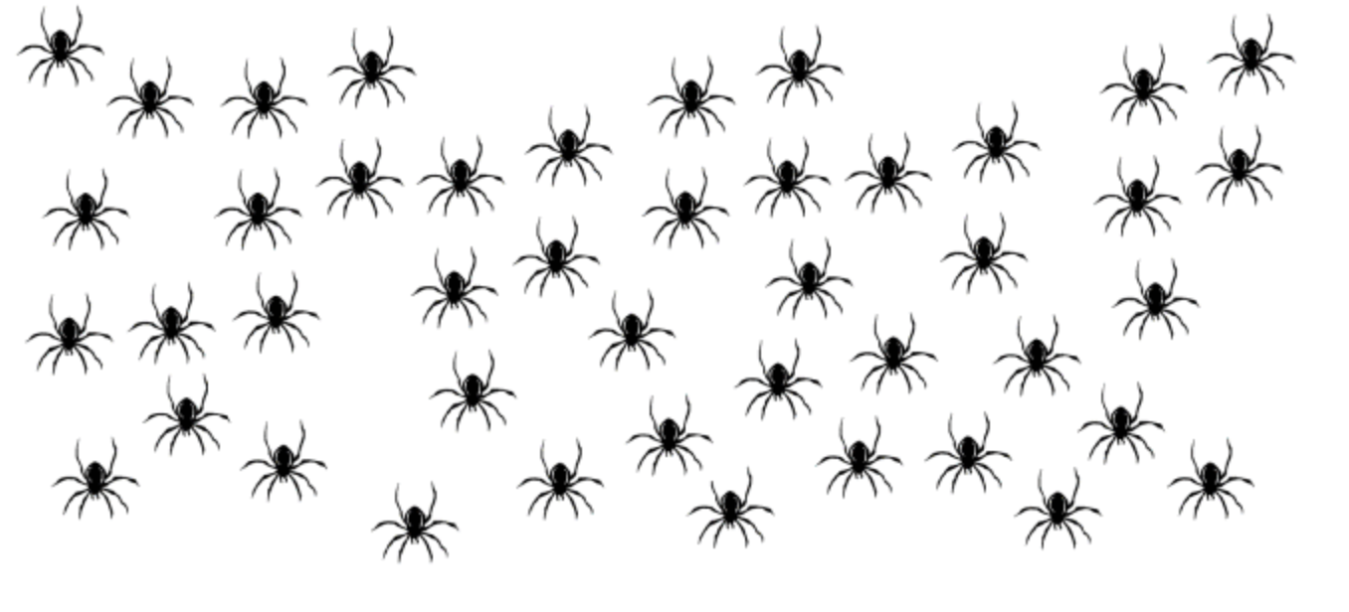

How can we count these accurately?

Slide 11
10

Slide 12
11

Slide 13
12

Slide 14
13

Slide 15
14

Slide 16
15

Slide 17
16

Slide 18
17

Slide 19
18

Slide 20
19

Slide 21
20

Slide 22
30

Slide 23
40

Slide 24
50

Slide 25
60

Slide 26
70

Slide 27
80

Slide 28
90

Slide 29
98

