Slide 1
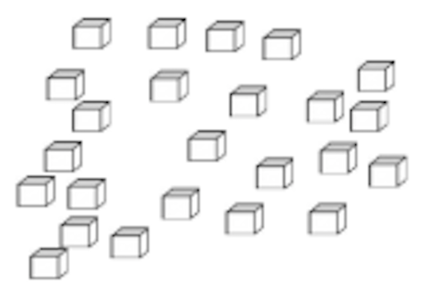

How can we count these accurately?

Slide 2
Group by tens

Slide 3
1

Slide 4
2

Slide 5
3

Slide 6
4

Slide 7
5

Slide 8
6

Slide 9
7

Slide 10
8

Slide 11
9

Slide 12
10

Slide 13
Record the ten

Slide 14
Record the ten

Slide 15
Count the next ten

Slide 16
1

Slide 17
2

Slide 18
3

Slide 19
4

Slide 20
5

Slide 21
6

Slide 22
7

Slide 23
8

Slide 24
9

Slide 25
10

Slide 26
Record the ten

Slide 28
Keep counting

Slide 29
1

Slide 30
2

Slide 31
3

Slide 32
4

Slide 33
10 + 10 + 4

Slide 34
24

Slide 35
How many all together?

